Slide 1

CLASSIFICATION OF AIR QUALITY INDEX USING KNN MACHINE LEARNING MODEL
FINAL YEAR PROJECT
PRESENTED BY: SUBMITTED TO:
RAHUL SRIVASTAVA DR. DEBANJAN ACHARYA
PRIYANSHU CHANDRA
AVNISH KUMAR
TUSHAR VERMA

Slide 2
CONTENT
INTRODUCTION
ABSTRACT
MOTIVATION
WHAT IS AQI?
AIR QUALITY SENSOR
K-NEAREST NEIGHBOURS MODEL
ADVANTAGE OF KNN
DATASET
DATA ANALYSIS
CODE SNIPPETS
FUTURE WORK

Slide 3
INTRODUCTION
Since most of the existing air quality index (AQI) predicting models focused on prediction of the time series data of a single target monitoring station, they failed to consider the correlation and mutual influence among the air quality monitoring station sites and the spatio-temporal characteristics of air quality. And this will lead to a certain one-sidedness during air quality prediction of a particular site. Aimed at this problem, a short-term air quality prediction model based on K-nearest neighbor (KNN). The model firstly used KNN algorithm to select the time and space-related monitoring stations, then the air quality index sequences of these stations were constructed into data sets, followed by training and testing processes in the model, and finally the model was verified with real data. It is suggested that the prediction accuracy of the hybrid prediction model constructed is acceptable in terms of the space-time correlation, and it could be an alternative for further application of air quality prediction.

Slide 4
The Environmental Protection Agency (EPA) tracks the commonly known criteria pollutants, i.e., ground-level ozone (O3), Sulphur dioxide (SO2), particulates matter (PM10 and PM2.5), carbon monoxide (CO), carbon dioxide (CO2), and nitrogen dioxide (NO2). These substances are in compositions of a common index, called the Air Quality Index (AQI), indicating how clean or polluted the air is currently or forecasted to become in areas. As the AQI increases, a higher percentage of the population is exposed. Different countries have their air quality indices, corresponding to different air quality standards. In India,the Environmental Protection Agency monitors six pollutants at more than 4000 sites: O3, PM10, PM2.5, NO2, SO2, and Lead.

Slide 5
ABSTRACT
Air, an essential natural resource, has been compromised in terms of quality by economic activities. Considerable research has been devoted to predicting instances of poor air quality, but most studies are limited by insufficient longitudinal data, making it difficult to account for seasonal and other factors. Several prediction models have been developed using an 11-year dataset collected by Taiwan’s Environmental Protection Administration (EPA). Machine learning methods, including adaptive boosting (AdaBoost), artificial neural network (ANN), random forest, stacking ensemble, and support vector machine (SVM), produce promising results for air quality index (AQI) level predictions. A series of experiments, using datasets for three different regions to obtain the best prediction performance from the stacking ensemble, AdaBoost, and random forest, found the stacking ensemble delivers consistently superior performance for R 2 and RMSE, while AdaBoost provides best results for MAE

Slide 6
MOTIVATION
The systems is a need in current age of development as the countries try to grow though industry the increase of using vehicles and other industries increases. Even though a person sees this as normal issue the chain of reactions that come through is quite devastating. The smog and the greenhouse effect are leading problems of this. Also the long term effect to the health of people living in these areas have to be considered. According to WHO More than 80% of people living in urban areas that monitor air pollution is exposed to air quality levels that exceed WHO limits.

Slide 7
WHAT IS AQI?
The air quality index (AQI) is an index for reporting air quality on a daily basis. It is a measure of how air pollution affects one's health within a short time period. The purpose of the AQI is to help people know how the local air quality impacts their health. The Environmental Protection Agency (EPA) calculates the AQI for five major air pollutants, for which national air quality standards have been established to safeguard public health.
1. Ground-level ozone
2. Particle pollution/particulate matter (PM2.5/pm 10)
3. Carbon Monoxide
4. Sulfur dioxide
5. Nitrogen dioxide
The higher the AQI value, the greater the level of air pollution and the greater the health concerns. The concept of AQI has been widely used in many developed countries for over the last three decades. AQI quickly disseminates air quality information in real-time.

Slide 8
AIR QUALITY SENSOR
Air pollution sensors are devices that monitor the presence of air pollution in the surrounding area. They can be used for both indoor and outdoor environments. These sensors can be built at home, or bought from certain manufactures. Although there are various types of air pollution sensors, and some are specialized in certain aspects, the majority focuses on five components: ozone, particulate matter, carbon monoxide, sulfur dioxide, and nitrous oxide.
The sensors were very expensive in the past, but with technological advancements these sensors are becoming more affordable and more widespread throughout the population. These sensors can help serve many purposes and help bring attention to environmental issues beyond the scope of the human eye.

Slide 9
K-NEAREST NEIGHBOURS MODEL
The K-nearest neighbors (KNN) algorithm is a type of supervised machine learning algorithms. KNN is extremely easy to implement in its most basic form, and yet performs quite complex classification tasks. It is a lazy learning algorithm since it doesn't have a specialized training phase. Rather, it uses all of the data for training while classifying a new data point or instance. KNN is a non-parametric learning algorithm, which means that it doesn't assume anything about the underlying data. This is an extremely useful feature since most of the real world data doesn't really follow any theoretical assumption e.g. linear-separability, uniform distribution, etc.
The intuition behind the KNN algorithm is one of the simplest of all the supervised machine learning algorithms. It simply calculates the distance of a new data point to all other training data points. The distance can be of any type e.g Euclidean or Manhattan etc. It then selects the K-nearest data points, where K can be any integer. Finally it assigns the data point to the class to which the majority of the K data points belong.

Slide 10
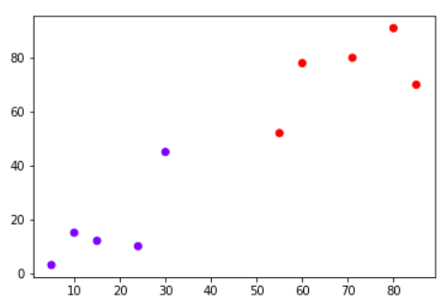
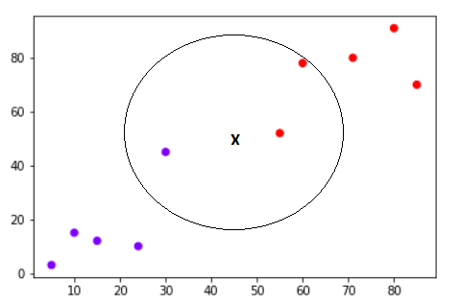
KNN CLASSIFICATION

Slide 11
ADVANTAGE OF KNN
It is extremely easy to implement
As said earlier, it is lazy learning algorithm and therefore requires no training prior to making real time predictions. This makes the KNN algorithm much faster than other algorithms that require training e.g SVM, linear regression, etc.
Since the algorithm requires no training before making predictions, new data can be added seamlessly.
There are only two parameters required to implement KNN i.e. the value of K and the distance function (e.g. Euclidean or Manhattan etc.)

Slide 12
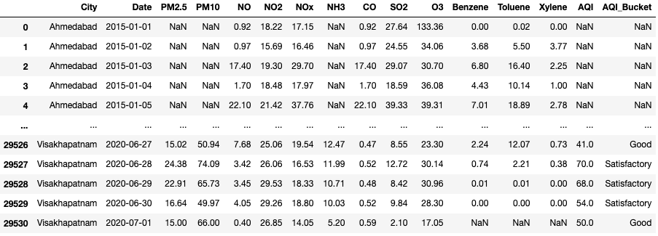
DATASET

Slide 13
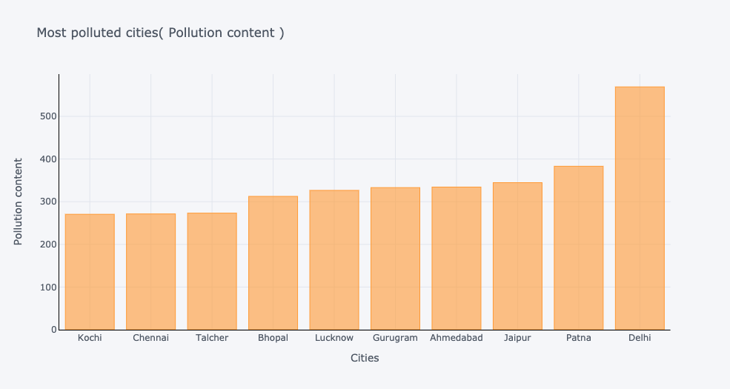
DATA ANALYSIS

Slide 14
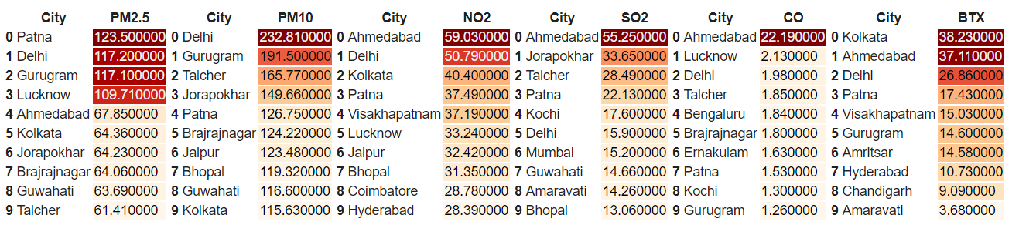
CITY WISE POLLUTANT ANALYSIS

Slide 15
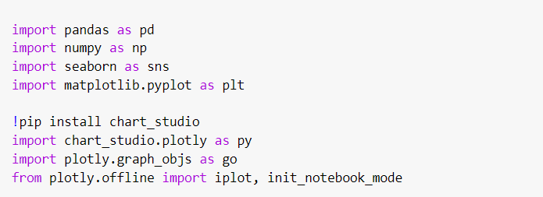
LIBRARIES

Slide 16
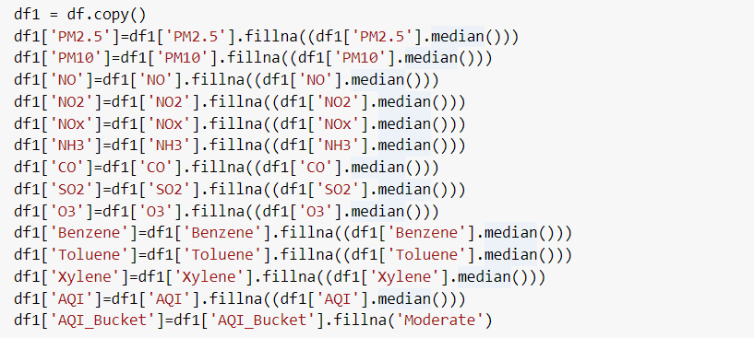
REMOVING NULL VALUES FROM DATASET

Slide 17
Code Snippets
import pandas_profiling
!pip install pycaret
from pycaret.classification import *
reg = setup(data = data,
target = 'AQI_Bucket',
silent = True)
compare_models()

Slide 18
FUTURE WORK
WE WILL TRY TO MAKE OUR DATASET MORE VAST AND COLLECTED FROM DIFFERENT SOURCES.
WE WILL TRY TO DEEP LEARNING MODELS TO GET MORE CORRECT RESULT.

Slide 19


